Slide 1
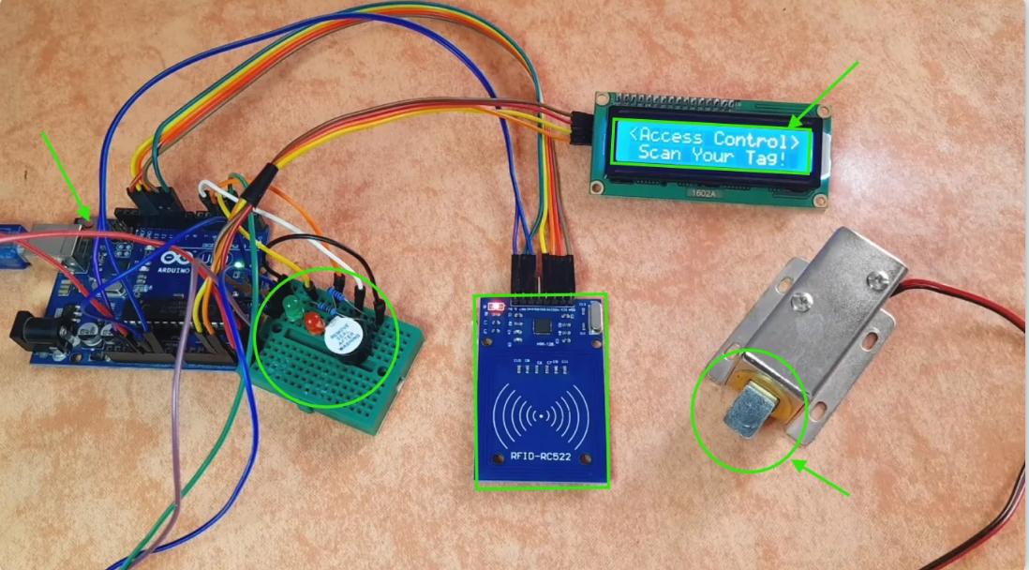
Secure entry system
Created by : Khaled Saad Fawzy Ahmed Mohamed Ramadan Boles Hessam Ahmed Hassan
Under supervision:
MARWA Elsediq

Slide 2
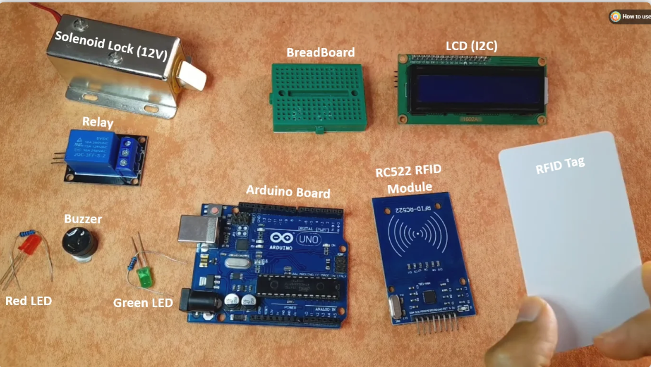

Slide 3
Diagram of electrical connections

Slide 4


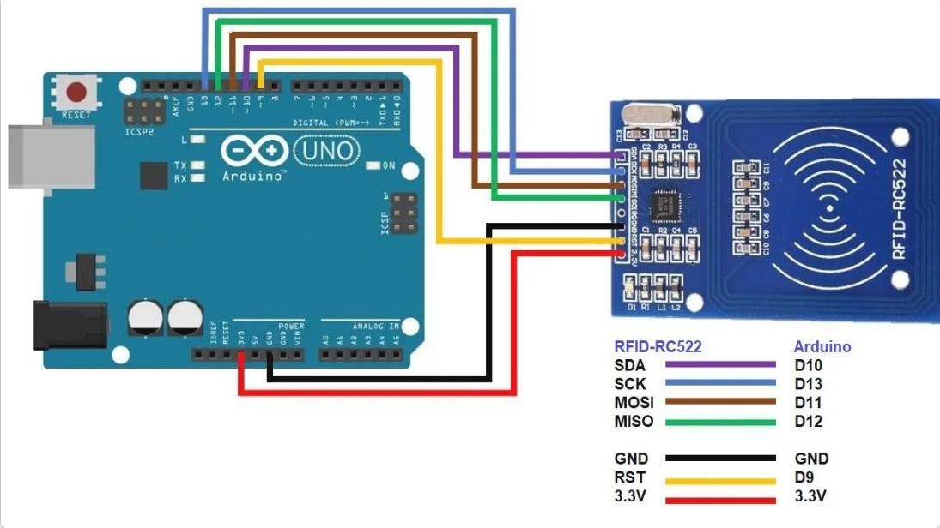




Slide 5
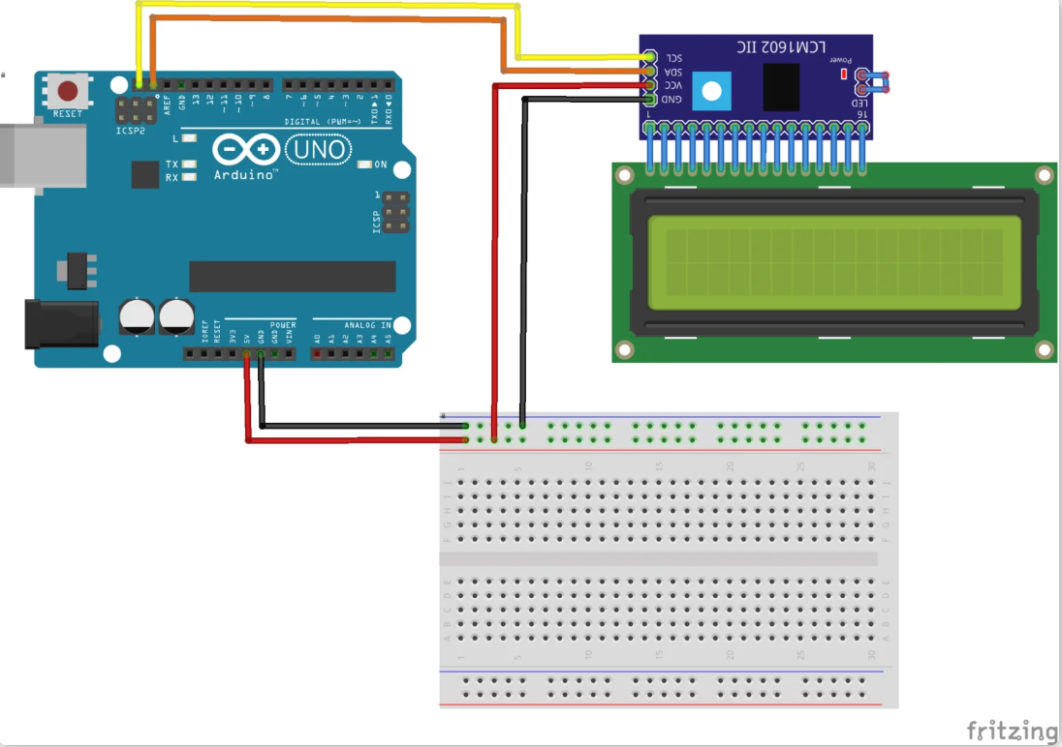


Slide 6
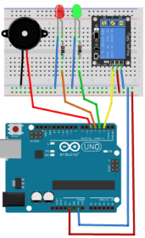
Buzer LED RELY
Buzer GND Buzer VCC | BORD GND / VCC
LED GRND LED VCC | BORD GND / VCC
NO | D2
Rely GND RELY VCC | BORD GND / VCC

